Slide 1
Professional Services:
Operational Responsibilities
Onboarding Presentation
ProServe Business Operations
Winter 2018

Slide 2
Agenda
Your First Few Weeks With ProServe
Time Entry & Utilization
Managing Your Schedule in PSA
Owning Your Current and Future Assignments
Logging Billable Expenses

Slide 3
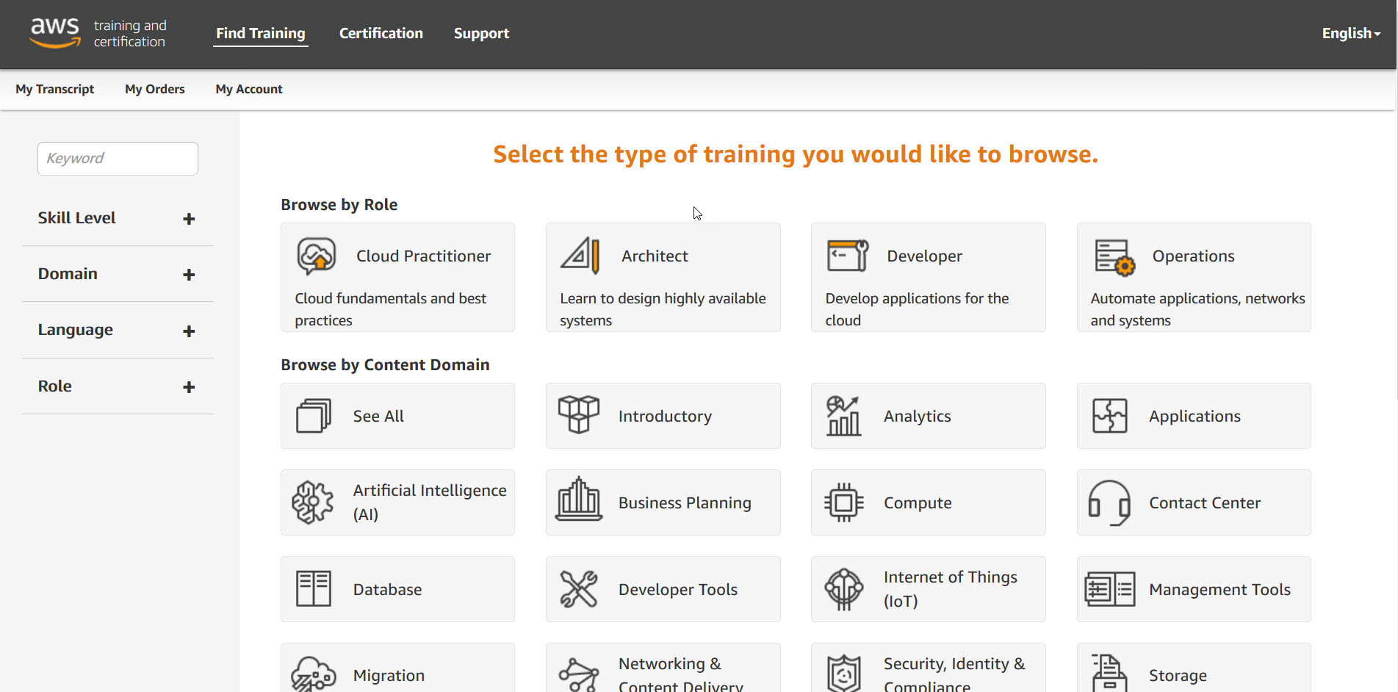
Your First Few Weeks With ProServe
Register for:
AWS Accelerate
Proserve Launch
Bookmark these pages:
New Hire Onboarding Wiki
Main Proserve Wiki
Timecard Wiki
Managing Your Scheduled Hours
Salesforce Homepage
Booking Travel Inside Amazon Page
Business Ops Team Contacts
Notes:
Provide a high level explanation of what Accelerate and Proserve Launch are, outcomes (Check Ride at Launch), and to sign up ASAP for Accelerate.

Slide 4
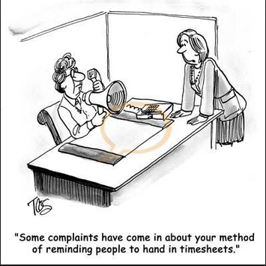
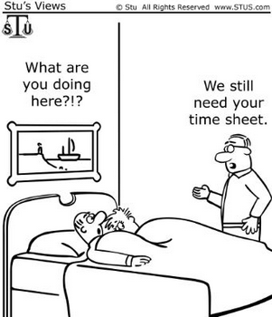

Slide 5
What’s the impact?
Customer Obsessed
Accurate and timely invoicing
Accurate Status Reporting
Insisting on the Highest Standards
Revenue Reporting
Utilization Reporting
(Hire and) Develop the Best
Understanding Resources’ skills and availability
Effective Staffing
Resource Availability
Effective Staffing
Notes:
Customer Obsession
Timely and accurate timecards directly impact customer experience during invoicing.
Timely and accurate timecards enable accurate status reporting to customers
Accurate schedules, timecards and skills profiles enables AWS to staff the right resource on the right project at the right time
Insist on the Highest Standards
Timecards and Schedules are the inputs that drive key reports used to manage the business
(Hire and) Develop the Best
Understanding resource’s skills and availability enables managers to properly assign and allocate work
It also helps ensure resources are assigned to challenging and career-growing assignments

Slide 6
Guidelines for Time Entry
Factual
Timecards are a record of how we are spending our time and provide useful information about how long activities take, which helps us provide more accurate estimate for future engagements. If you are doing work for a client project, charge that time to the project. If you have a question about whether or not that time is billable ask the project manager.
Friday
Save your timecard throughout the week, including notes about work delivered. And remember to submit your timecard by close of business every Friday! Always use “Time Entry" from the left-hand menu (scroll down past the Recent Items group).
Forty +
Enter at least 40 hours in your timecard each week. If between projects use your time to train and build new skills in either classroom or online training.
Forecast
Peek at what is planned for next week. If the hours or projects on your resource planner do not look right, update the resource planner or reach out to your Operations Manager and/or Practice Manager to review and adjust assignments. We are currently forecasting work for the full duration of the project and planning for pipeline 2-3 months in advance.

Slide 7
How is Utilization Calculated?
Calendar Hours
Calendar hours are your scheduled hours for the period. The default is 40 hours/week for full time consultants.
Time charged to the project Vacation/sick/personal is deducted from the Calendar hours. E.g. If you take Friday off and charge this time to vacation/sick/personal your calendar hours for the week reduce from 40 hours to 32 hours.
Time on billable assignments
Time on investment assignments
Total Utilization
Calendar Hours (Minus PTO/Holiday if applicable)
Notes:
Call out that you are NOT penalized if you have 40 hours of UTE credited assignments and an additional 6 hours of sales support, etc

Slide 8
Timecard Categories & Utilization Credit
Project | Assignment Type | Description | Utilization Eligible?
Customer Project | Billable | Assignment for which a customer will be charged an hourly rate for your time | Y
Customer Project | Investment | Assignment for which a customer has been granted "free" time towards a project | Y
Investment (No SOW) | Shadow Assignment | This project and milestone combination tracks any investment we are making in an AWS consultant to enable their growth and effectiveness. This includes shadow assignments within the first 60 days of hire date or when a consultant is learning about a new specialty/topic or during transition periods (one consultant taking the place of another on an engagement). Maximum of 80 hours per shadow assignment. | Y
Notes:
Reiterate that Operations creates utilized assignments
Consultants can create self assignment for forecasting and planning

Slide 9
Timecard Categories & Utilization Credit
Project | Assignment Type | Description | Utilization Eligible?
New Hire Onboarding |  | For use by new hire , this project tracks time spent on new hire activities. Max 320 hours. | N
Sales Support |  | For use by Consultants and Practice Managers, this project tracks time spent in discovery meetings, proposal preparation, legal contract reviews, T&C’s negotiations, relationship mgt, & customer meetings for a specific Opportunity. Identifying a milestone and opportunity are required. | N
Conferences |  | This assignment is used to track time spent attending conferences and events such as Technical Summits. | N
Notes:
Note that not all new hires take the full 320 hours to ramp
Note that sales support should be used selectively (sales team should be leveraging SAs before Consultants)

Slide 10
Timecard Categories & Utilization Credit
Project | Assignment Type | Description | Utilization Eligible?
Builder Projects |  | This project tracks time building a scalable solutions for the ProServe business. | N
Internal Training |  | This assignment tracks time spent on training including: self-guided training, classroom based learning, online courses, industry conference, or anything else that contributes to your overall skills/certifications. | N
Travel Time |  | This assignment tracks non-billable time spent traveling. If you do client work while traveling (on a plane or train), that time should be recorded against the customer project. The remaining time you’re not working while traveling should go here. | N
Notes:
Emphasize that we only bill a customer for time spent traveling if work/deliverables have been accomplished. All time spent in a taxi the airport, on an airplane not working etc, should be logged as travel time

Slide 11
Timecard Categories & Utilization Credit
Project | Assignment Type | Description | Utilization Eligible?
Vacation/Sick/Personal |  | This assignment tracks paid time off, sick leave, and personal leave. Time charged to Vacation/Sick/Personal reduce the number of hours in the denominator for utilization calculations. This includes maternity and paternity leave of absence. | Excluded
Recruiting |  | This project tracks time supporting the hiring of AWS professionals including: phone screens, interviews, time entering feedback into tools, debriefs and attending recruiting events. | N
Admin |  | This project tracks time on administrative duties such as timecards, expenses, people mgt., and other job responsibilities that don’t have a separate milestone/project. | N

Slide 12
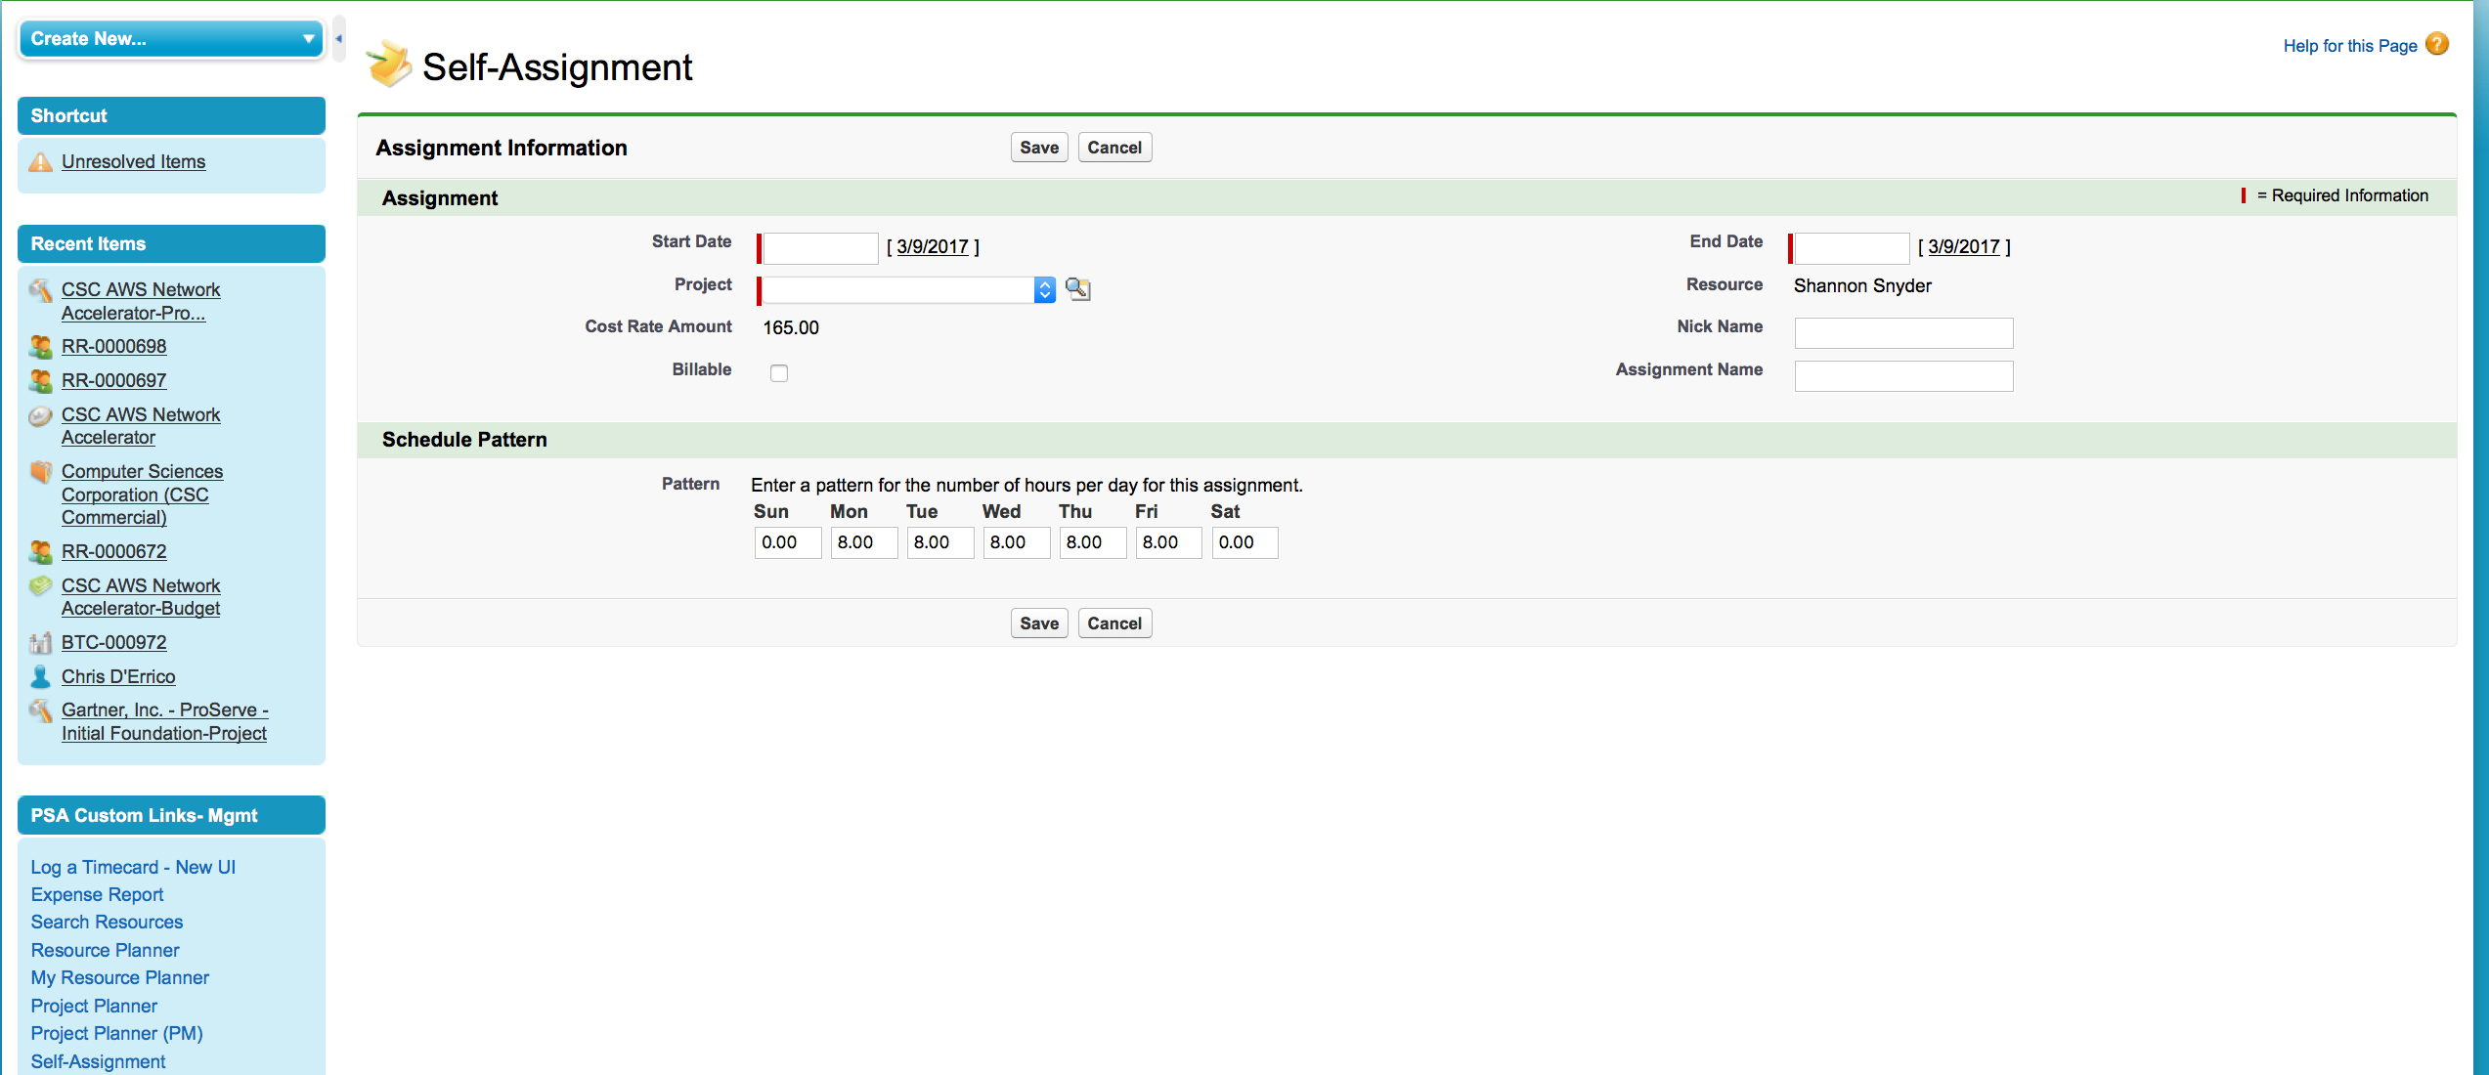
Creating a Self Assignment
Select global project that best fits your future activity using the search icon for projects. Available global projects include:
Admin
Vacation/Sick/Personal
Internal Training
Holidays
Internal Projects
Travel Time
Sales Support
Recruiting/Interview
When taking PTO:
Log it to Amazon HR Timeoff Website in addition to blocking off time in your planner!

Slide 13
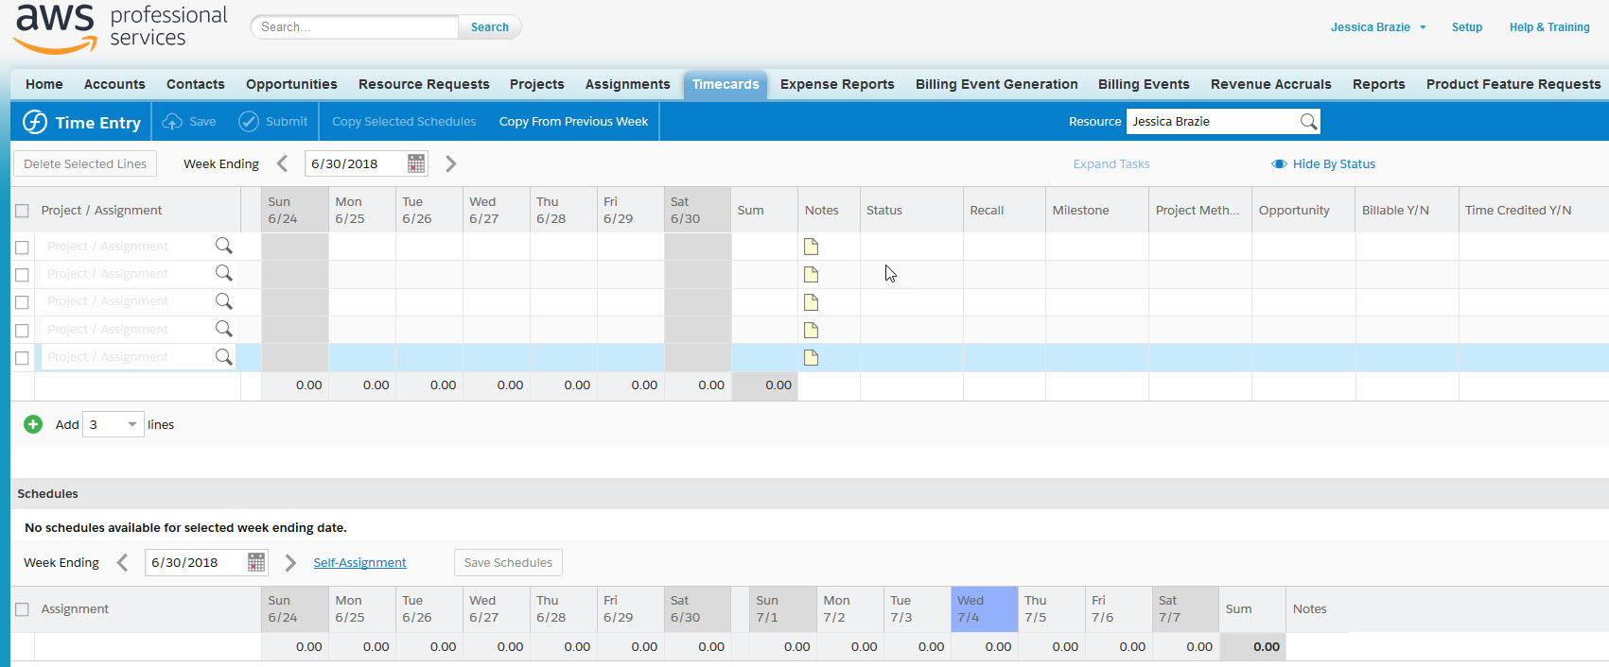
Logging Your Time
From the SFDC Home Page, click on “Time Entry” under “PSA Custom Links”
Some assignments require Milestones. In the milestones column, you will be able to view a dropdown to designate which milestone to charge your time against.
Notes:
*DEMO*
- Open SFDC home page, show left side menu bar
- Point out that grey triangle hides/makes the menu bar visible
- Click on self assignment
- Create an assignment for vacation/sick/personal
Then, navigate to time entry
Log a timecard towards your assignment

Slide 14
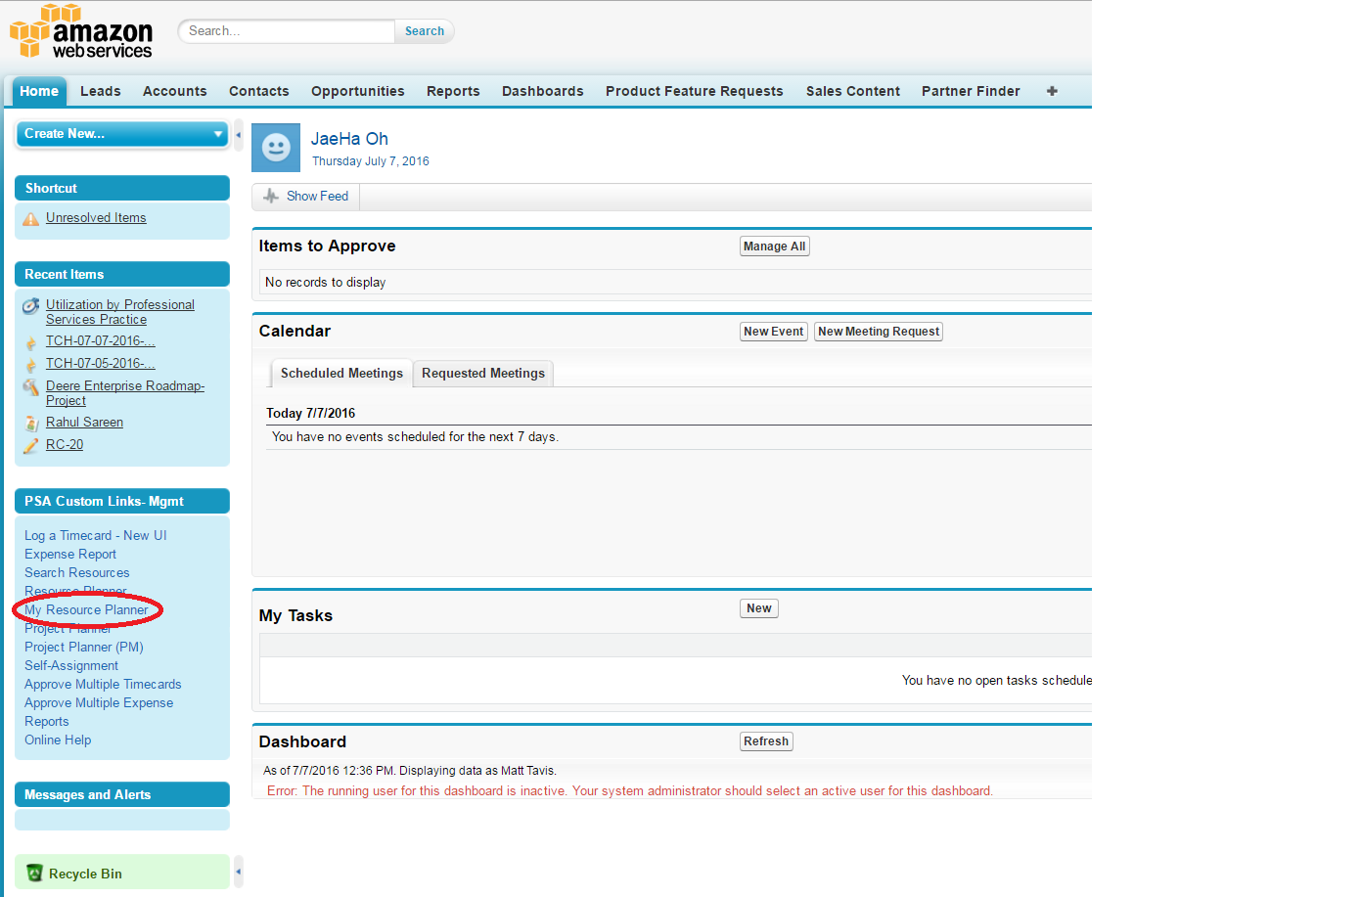
Owning Your Schedule
If this is your first time in the Resource Planner view, you may want to remove all the columns that are not relevant. Specialty Practice may be the only column that is relevant and all others can be unchecked.
Notes:
*DEMO
- Call out that you should update your planner every time you get a new assignment in addition to every Friday when you submit your timecard. When Ops flips a RR, hours are done in a “peanut butter spread”
- Forecast should be accurate for 4+ weeks

Slide 15
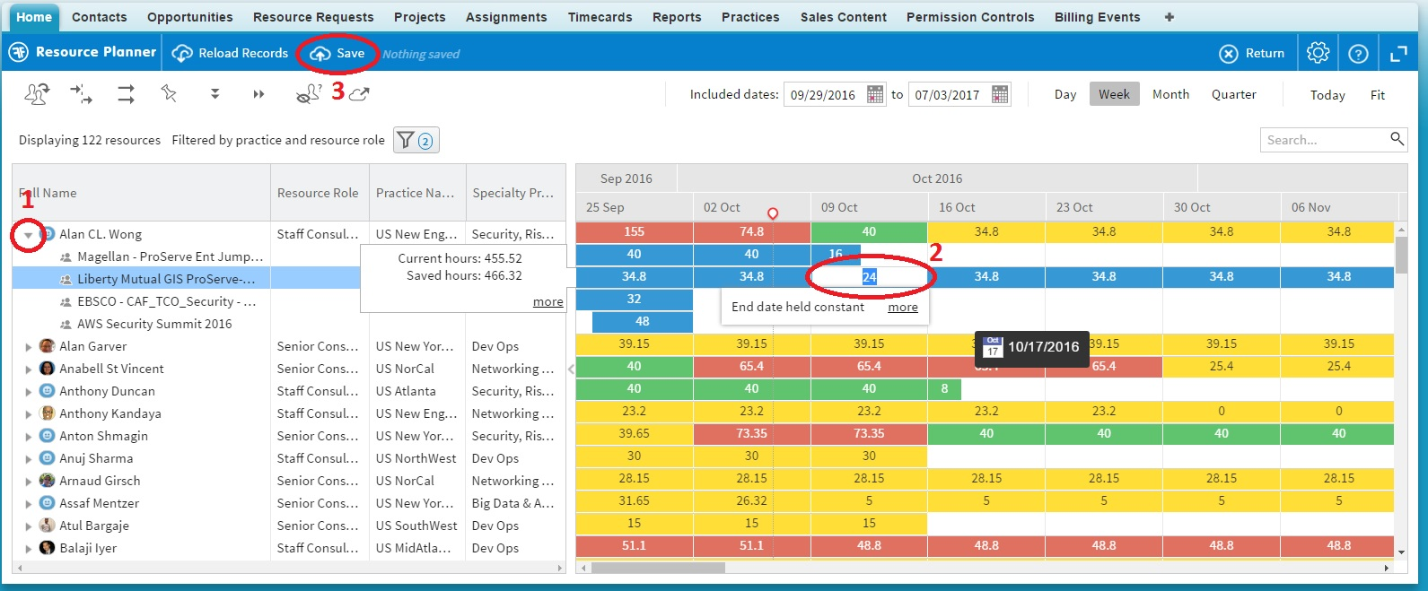
Owning Your Schedule
Once you've cleaned up your view:
1) Click the grey triangle to the left of your name to expand the list of your current assignments. If your assignment has already expired, change the "Included dates" range and Reload Records.
2) Double click the blue rectangular cell for the week and assignment you would like to update. You can also click and drag the assignment to adjust the start and end date OR you can click and drag the end of the assignment to adjust your end date.
3) Click Save to update your assignment and scheduled hours.
Notes:
Open SFDC to walk them through the steps in the previous and current slides:
RP columns/customization
Expanding list of assignments
Changing hours and assignment end dates 2 ways: 1) editing within each week, dragging out assignment end date and 2) applying a schedule pattern to spread hours evenly, manually edit assignment end date

Slide 16
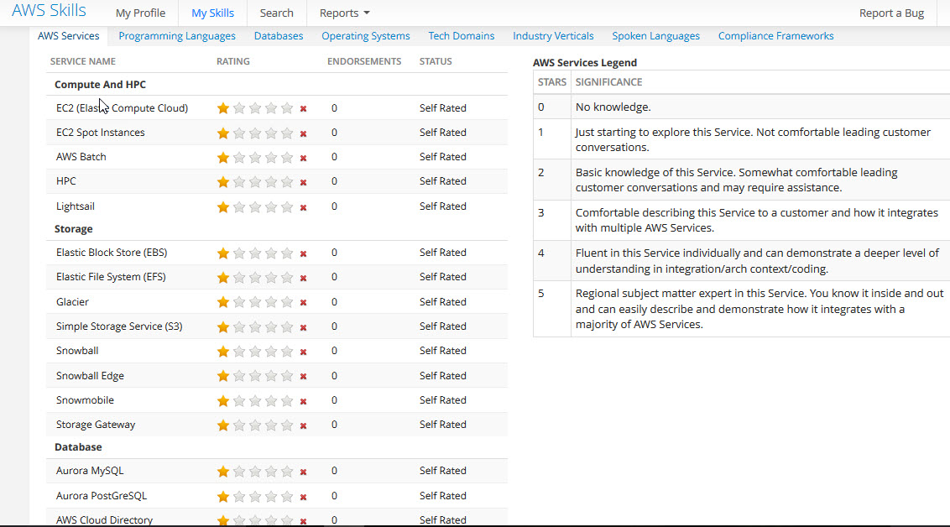
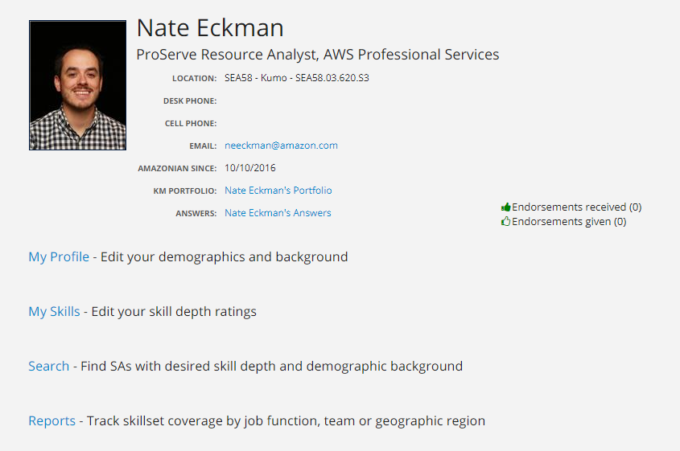
Driving Your Future Assignments
View upcoming launched or committed projects: https://na32.salesforce.com/00O380000046Uwv
Keep your resource planner up-to-date
Raise your hand! Inform the Project Manager and your line Manager if you are finishing a project early or the workload is not what you expected
Review the Shadow eligible Resource Request report
Ensure your Skills Profile is updated every 90 days
*Some 4+ Star ratings (SME) require approval from a
Technical Field Committee (TFC)
Notes:
Why is the Skills Tool important?
It is important consultants accurately reflect their truly ability and comfort level with an AWS service, programing language, etc. in the Amazon skills database. It is important to do not over state, or understate our comfort level as these are used to help determine if the prospective consultant is the right fit for the role. The business impact of delays in staffing roles with the right consultant can cause CSAT issues and decrease utilization.

Slide 17
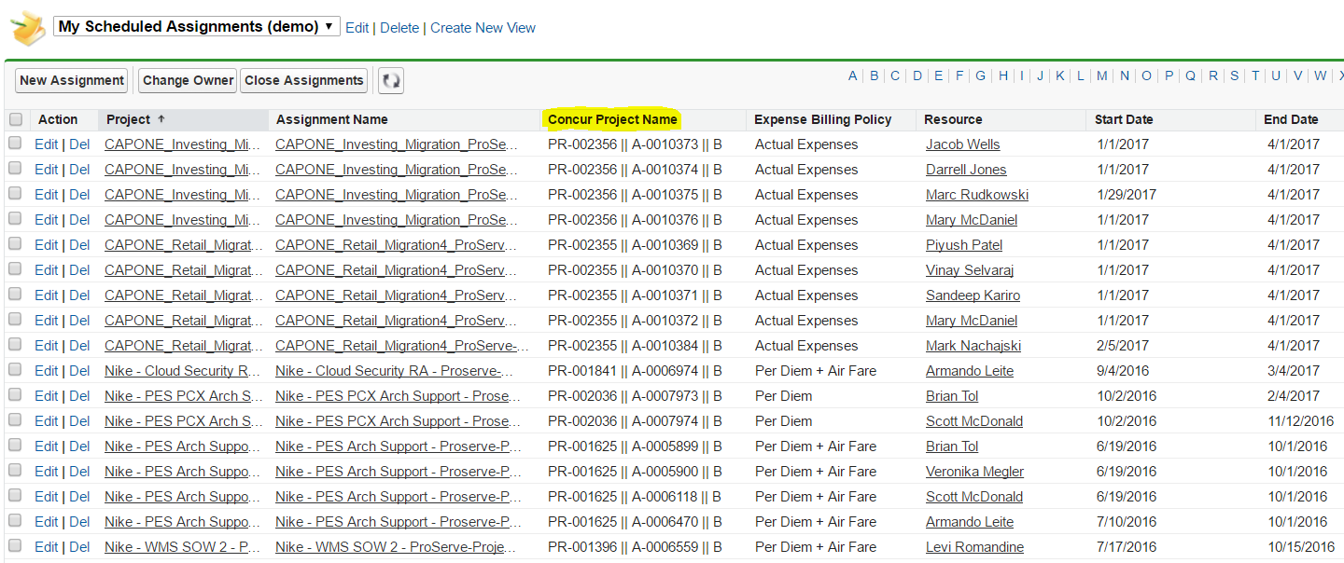
Logging Expenses
Bookmark the following:
Concur wiki
Concur website | Mobile App Info
Concur/PSA wiki (only relevant when we’re billing the customer for your expenses)
Before submitting expenses in Concur, go to the Assignment tab to view your active assignments, find the ‘Concur Project Name’. This is what you will copy and paste in its entirety into the ‘Business Purpose’ Field in Concur
Notes:
DEMO-

Slide 18
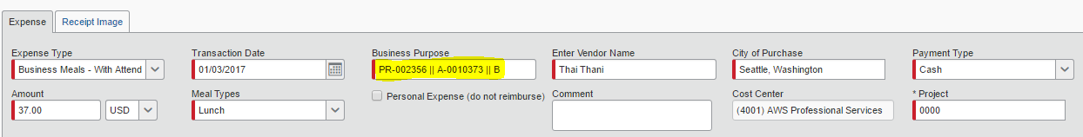
Logging Expenses
Expenses should be submitted weekly (we are customer obsessed)
Note that for an investment/AI assignment, you will have a separate assignment with a bill code for expense entry
For expenses to be billed back to the customer:
Your assignment MUST BE BILLABLE (end in B)
Your expenses must be within the assignment start and end date
You must copy and paste the entire code within the correct Concur field
You should not use the 3m* card for payment when booking trips in Concur
If you make a mistake on your expense report, please reach out to your Ops Manager!
Notes:
Stress the point that when booking flights the 3M card is not to be used for customer engagements
Point out the common gotcha that the Project is to be left as 0000 and the link to bill the customer is using the Concur Project Name in Business Purpose field
Note that you can use either an Amazon Corp card or personal card (get your points) for expense reimbursement

Slide 19
Please reach out to your Business Operations Manager for additional support
Thank you!

